Slide 1
WELCOME
TO OUR PRESENTATION

Slide 2
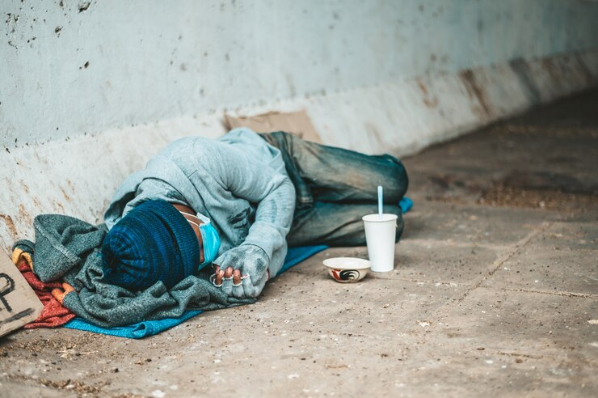
POVERTY
Presenter by-
Md. Bokhtear Hossain
ID: B00330
Date: 23 March, 2024

Slide 3
Introduction:
Today we're talking about poverty, a big problem affecting lots of people around the world. It's when people don't have enough money to live well. We'll learn why it happens and what we can do about it. Let's start exploring together!

Slide 4
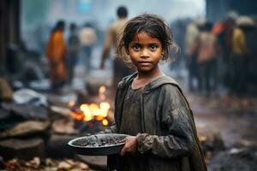
Causes of Poverty :
Lack of access to education
Unemployment and underemployment
Economic inequality
Discrimination based on race, gender, or ethnicity
Limited access to healthcare and social services

Slide 5
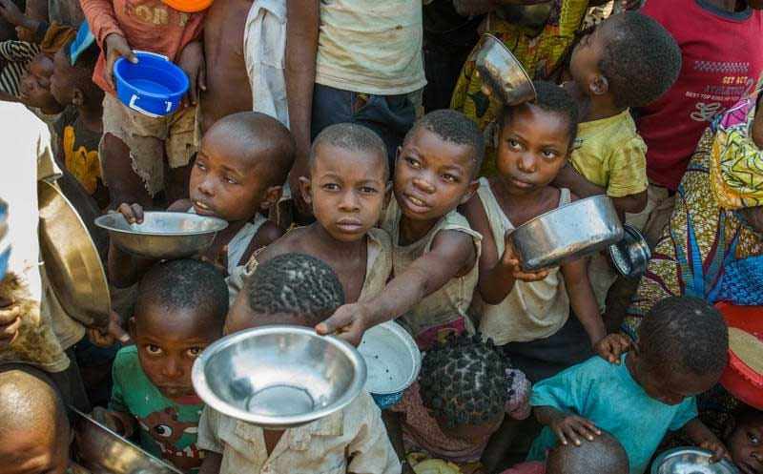
Impact of Poverty:
Malnutrition and food insecurity
Poor healthcare access and higher mortality
Limited education and lower academic achievement
Social exclusion and marginalization
Increased stress and mental health issues

Slide 6
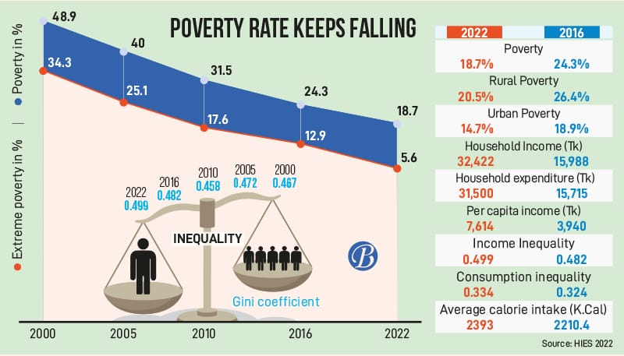
Statistics:

Slide 7
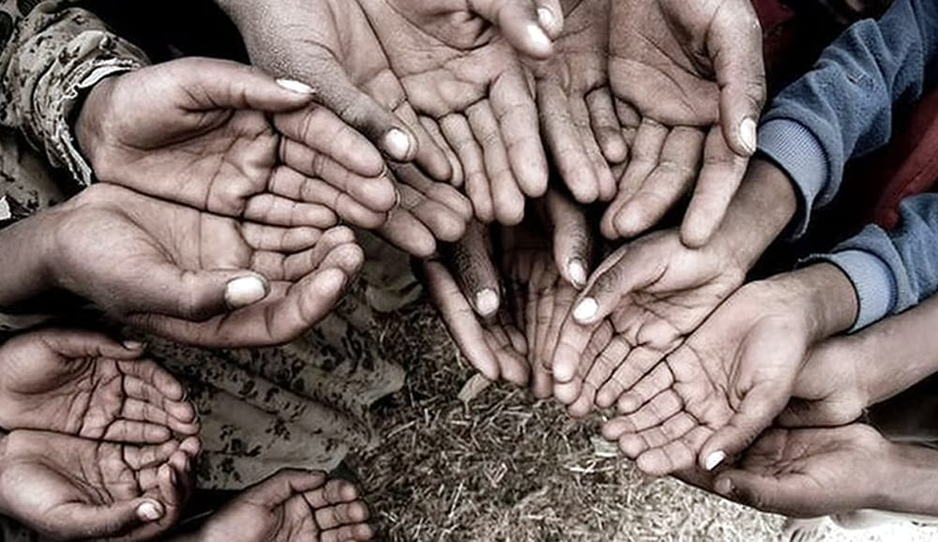
Types of Poverty:
Absolute poverty
Relative poverty
Rural poverty
Urban poverty
Generational poverty

Slide 8
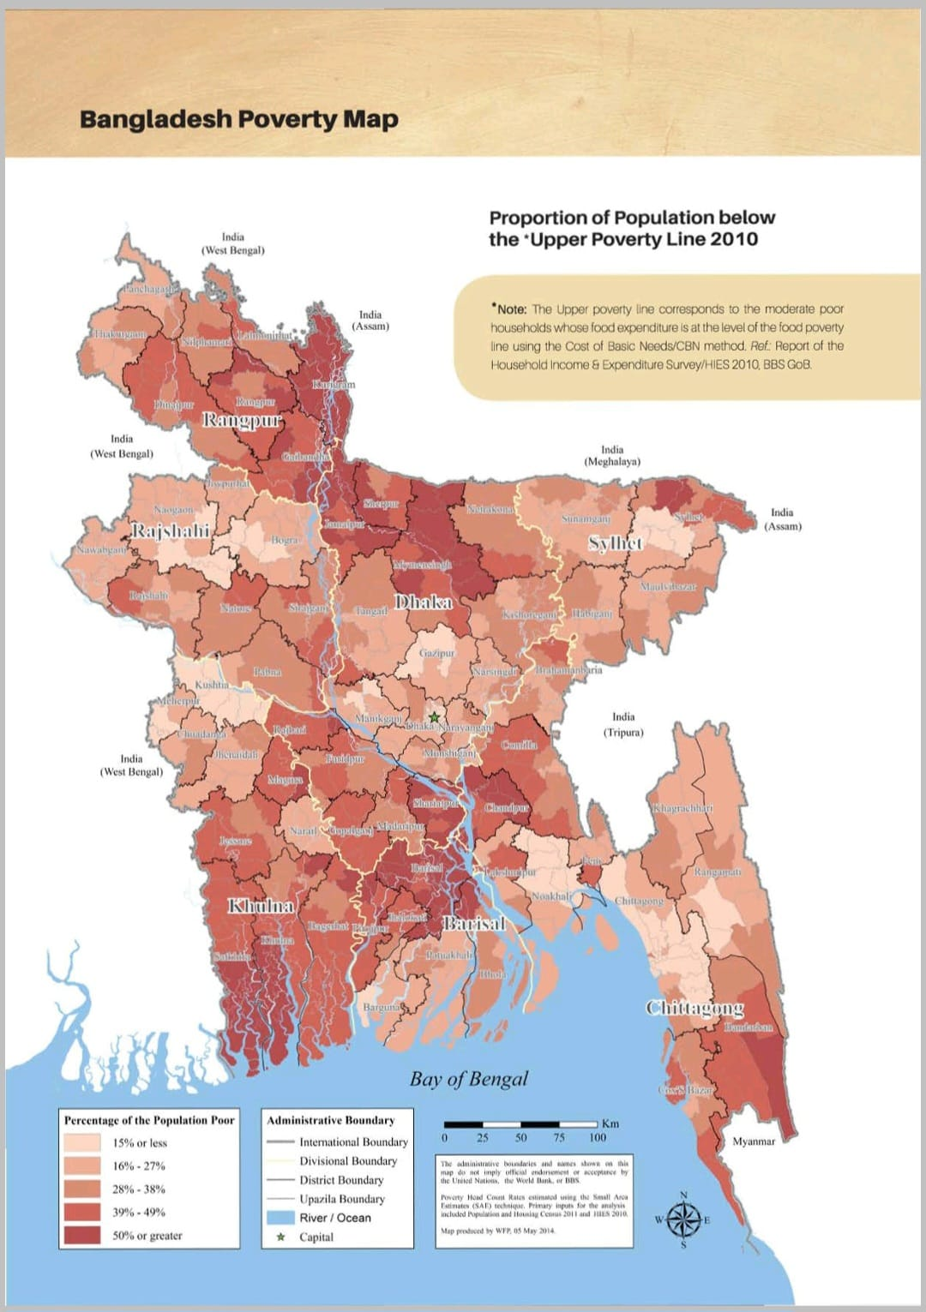
Poverty Map BD:
This map illustrates poverty distribution across Bangladesh, showcasing areas with higher concentrations of economic hardship.

Slide 9
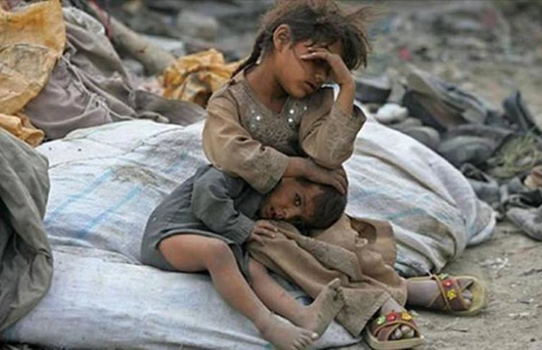
Category of Poverty :
Absolute Poverty:
Lack of basic necessities like food, water, and shelter.
Often measured by an income threshold below which individuals cannot afford basic needs.

Slide 10
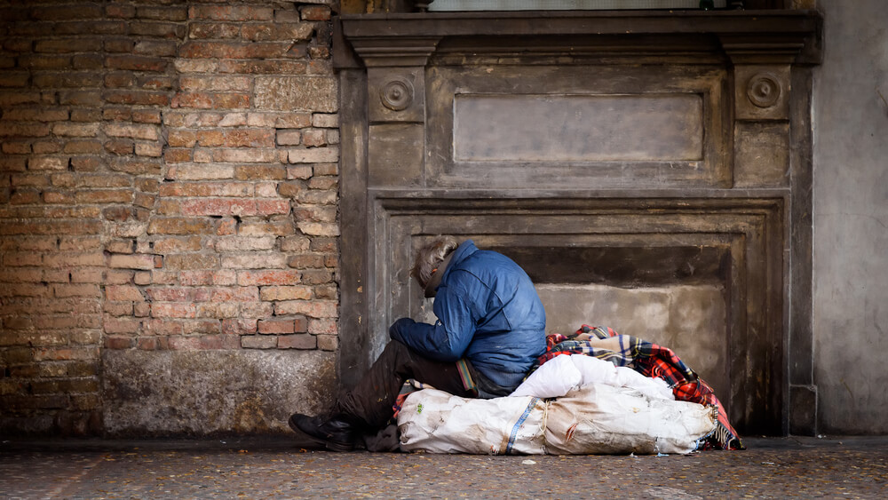
Cont…
Relative Poverty:
Defined in relation to the economic status of others in society.
Individuals may not be deprived of basic necessities but have significantly lower income or resources compared to the average.

Slide 11
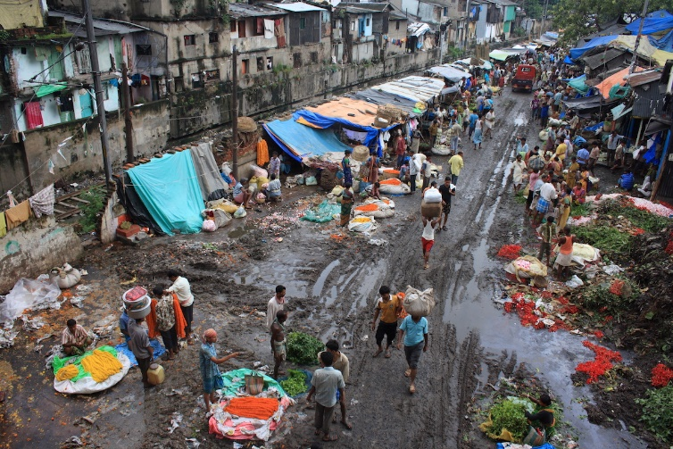
Cont…
Rural Poverty:
Predominantly found in rural areas where access to resources and opportunities is limited.
Often associated with agriculture-dependent economies and lack of infrastructure.

Slide 12
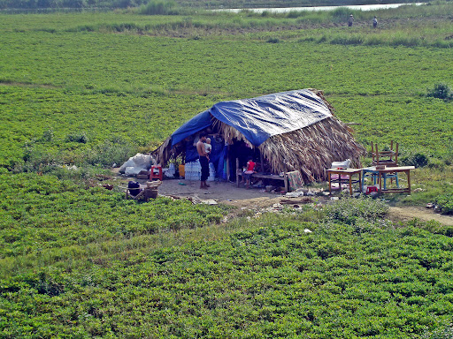
Cont…
Rural Poverty:
Predominantly found in rural areas where access to resources and opportunities is limited.
Often associated with agriculture-dependent economies and lack of infrastructure.

Slide 13
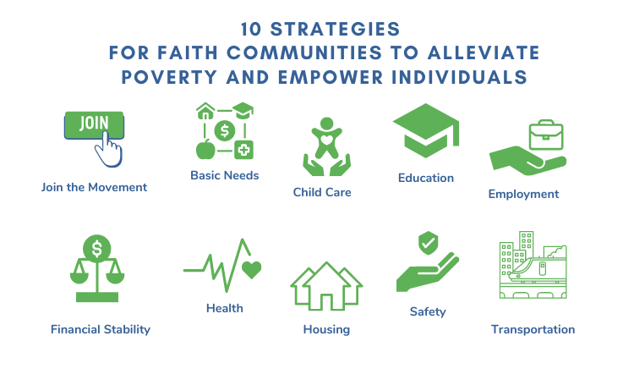
To mitigate poverty :

Slide 14
Conclusion:
Poverty is a multifaceted challenge with far-reaching implications. By addressing its root causes, fostering community engagement, implementing effective policies, and promoting economic empowerment, we can work towards a more equitable and poverty-free world.

Slide 15
Thank You! ☺

